Slide 1
Resource-Aware Edge-Cloud Framework for Reinforcement Learning-based Intelligent Traffic Signal Control and Anomaly Detection
Supervisor: Prof. Dulani A Meedeniya
Presented By: Lakshitha Konara

Slide 2
Table of contents
01
02
03
04
05
06
Introduction
Literature Review
Core CS problem, background, problem & research statement, objectives
Existing solutions 2016–2026 and the gap that persists
Proposed Solution & Methodology
Novelty & Contribution
How this work differs from existing research
Framework design, verified datasets, evaluation criteria
Feasibility Analysis
Research Timeline
Technical, operational, financial and legal / ethical feasibility
24-month project schedule

Slide 3
01
Introduction

Slide 4
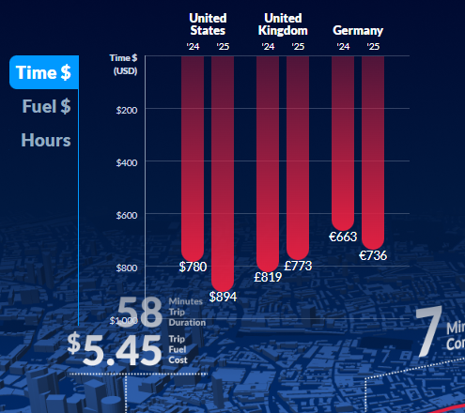
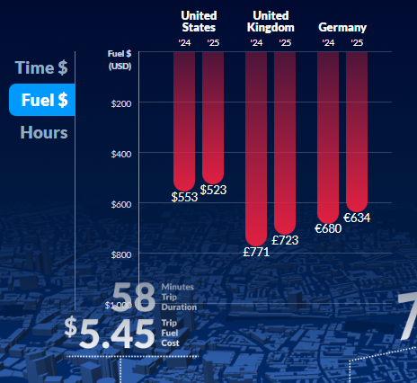
Urban Traffic & the Rise of Edge-IoT ITS
Rapid urbanization is increasing traffic volumes, congestion, and delayed incident response in cities worldwide.
Intelligent Transportation Systems (ITS) increasingly rely on IoT sensors and edge devices deployed close to intersections, rather than centralized cloud processing alone.
Source: INRIX 2025 Global Traffic Scorecard

Slide 5
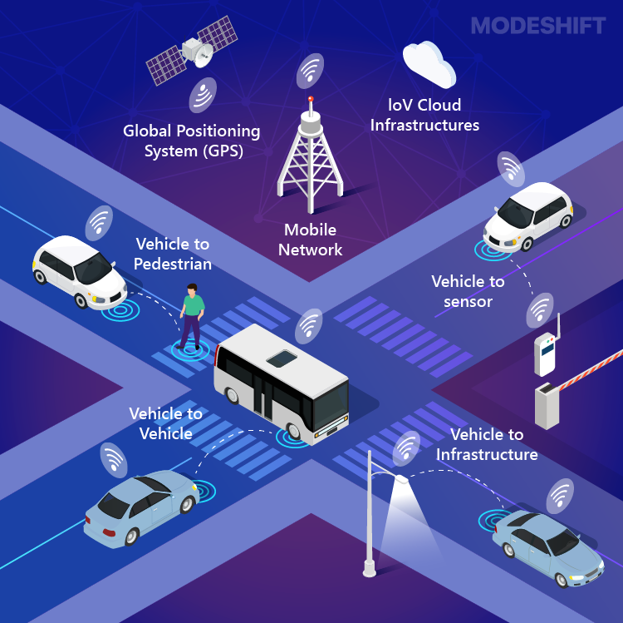
Urban Traffic & the Rise of Edge-IoT ITS (Contd…)
Edge devices bring speed and autonomy, but also strict compute, memory, and energy constraints that most research ignores.

Slide 6
Background
Traditional signal systems use fixed-time or simple actuated logic (no real-time adaptation).
Reinforcement Learning (RL) has shown strong results for adaptive signal control, but mostly evaluated assuming unconstrained compute.
Traffic anomaly detection research is typically developed and tested independent of deployment constraints.
Edge-cloud offloading (deciding what runs locally versus in the cloud) is well-studied in distributed systems / IoT, but rarely co-designed with the learning-based control and detection modules.

Slide 7
Problem Statement
Reinforcement-learning-based control and ML-based anomaly detection are predominantly designed under the assumption of unconstrained computational resources, while existing edge–cloud offloading strategies are developed independently of the learning components they support - leaving no unified, resource-aware framework that jointly co-designs sequential control, multi-tier inference, and adaptive offloading under explicit latency, energy, and memory constraints.

Slide 8
Research Statement
A unified, resource-aware framework that jointly co-optimises RL-based sequential control, multi-tier anomaly detection, and a confidence-aware dynamic edge–cloud offloading policy can be designed to operate reliably under explicit latency, energy, and memory constraints yielding accuracy–latency–energy trade-offs that improve upon independently designed components.

Slide 9
The Core CS Problem
Distributed intelligent systems must run under real resource limits (not the unconstrained compute most ML/RL research assumes).
Constrained Sequential Decision-Making
Multi-Tier Inference
Adaptive Computation Offloading
RL research assumes unconstrained compute; policy quality under real edge latency/memory budgets is poorly understood.
Anomaly/ML detection pipelines are benchmarked independent of where they run, hiding accuracy-latency-energy trade-offs.
Distributed-systems offloading strategies rarely account for the learning component's own confidence/uncertainty.
Core CS Contribution: A unified framework that co-designs RL control, multi-tier detection, and confidence-aware offloading as one optimization problem with a reproducible, containerized methodology to measure accuracy–latency–energy trade-offs, generalizable beyond any single application.

Slide 10
Objectives
01
02
03
04
Design and implement a resource-aware RL control algorithm that operates under explicit latency and compute constraints, benchmarked against fixed-time and actuated baselines (traffic light with sensors and simple rules).
Develop a multi-tier (edge/cloud) anomaly detection pipeline and characterize the accuracy–latency–energy trade-off between the two model variants.
Design a confidence-aware, resource-adaptive offloading algorithm driven by model confidence, device load and network conditions.
Integrate all three into a unified, reproducible framework and establish generalizable design patterns for resource-constrained distributed systems.

Slide 11
02
Literature Review

Slide 12
Existing Solutions
Research addresses these three areas largely in isolation:
Adaptive Signal Control
Forecasting & Detection
Edge–Cloud Offloading
Surveys & Reviews
Genders & Razavi (2016) – DQN
Wei et al. (2018) – IntelliLight
Nguyen et al. (2025) – T-REX,
RL robustness under incidents
AlSaqabi (2026) – PPO, IoT
Li et al. (2018) – DCRNN
(origin of METR-LA / PEMS-BAY)
Peddiraju et al. (2024) –
IncidentNet, 98% at 81.4% sparsity
Duan et al. (2025) – HGNN + CPLE
Shi et al. (2016) – edge survey
Behera et al. (2024) – confidence-
based hierarchical inference
Moothedath et al. (2026) – AAAI
Saha & Debroy (2026) – CCGrid
Xiao, H. et al. (2026) – RL-TSC
survey (AI Review)
Xiao, F. et al. (2025) – RL-TSC review
Ngo et al. (2025) – edge inference
review (Electronics)

Slide 13
Existing Solutions (Contd…)
Study (year) | Focus | Dataset / testbed | Resource or deployment aware?
Genders & Razavi (2016) Wei et al. (2018) – IntelliLight | Foundational RL signal control | SUMO; real + simulated intersection data | No
Nguyen et al. (2025) – T-REX | Robustness of RL signal control under incidents | SUMO; synthetic and real networks with rerouting | No (robustness studied, computational cost is not)
Xiao, F. et al. (2025) – review | Advances in RL for traffic signal control | N/A (review) | Names the gap: "limited analysis from an engineering implementation standpoint"
Xiao, H. et al. (2026) – survey | RL-based traffic signal control | N/A (survey) | Lists computational cost, sim-to-real and real-time scalability as open problems
AlSaqabi (2026) | RL signal control for IoT-enabled intersections | SUMO; real signalised intersection, Kuwait | No (despite the IoT framing: offline training, no latency, memory or power figures)

Slide 14
Existing Solutions (Contd…)
Work | Adaptive Control | Anomaly Detection | Multi-Tier (Edge/Cloud) | Resource-Constraint Aware | Confidence-Aware Offloading | Real-World Data Validation | Reproducible / Open Framework
Genders & Razavi (2016) | ✓ | ✗ | ✗ | ✗ | ✗ | ✗ | ●
Wei et al. (2018) - IntelliLight | ✓ | ✗ | ✗ | ✗ | ✗ | ✓ | ●
Li et al. (2018) - DCRNN | ✗ | ✗ | ✗ | ✗ | ✗ | ✓ | ✓
Shi et al. (2016) - survey | ✗ | ✗ | ✓ | ✓ | ● | ✗ | ✗
Peddiraju et al. (2024) - IncidentNet | ✗ | ✓ | ✗ | ● | ✗ | ● | ✓
Behera et al. (2024) - Hierarchical Inference | ✗ | ✗ | ✓ | ✓ | ✓ | ✗ | ✓
Nguyen et al. (2025) - T-REX | ✓ | ● | ✗ | ✗ | ✗ | ✓ | ✓
Ngo et al. (2025) - review | ✗ | ✗ | ✓ | ✓ | ● | ✗ | ✗
Duan et al. (2025) | ✗ | ✓ | ✗ | ✗ | ✗ | ✓ | ✗
AlSaqabi (2026) | ✓ | ✗ | ✗ | ✗ | ✗ | ✓ | ●
Moothedath et al. (2026) - AAAI | ✗ | ● | ✓ | ✓ | ✓ | ✗ | ✓
Saha & Debroy (2026) - CCGrid | ✗ | ✗ | ✓ | ✓ | ✗ | ✓ | ●
Proposed Framework | ✓ | ✓ | ✓ | ✓ | ✓ | ✓ | ✓

Slide 15
03
Proposed Solution & Methodology

Slide 16
Proposed Solution
An intersection-level framework combining adaptive signal control with anomaly-aware, resource-constrained edge-cloud offloading.
Adaptive Signal Control (RL)
Anomaly Detection Module
Edge-Cloud Offloading Policy
Observes queue length & wait time; selects signal phase to minimise delay
Decides local vs. cloud processing based on latency / energy / confidence
Lightweight edge model + accurate cloud fallback for incident detection

Slide 17
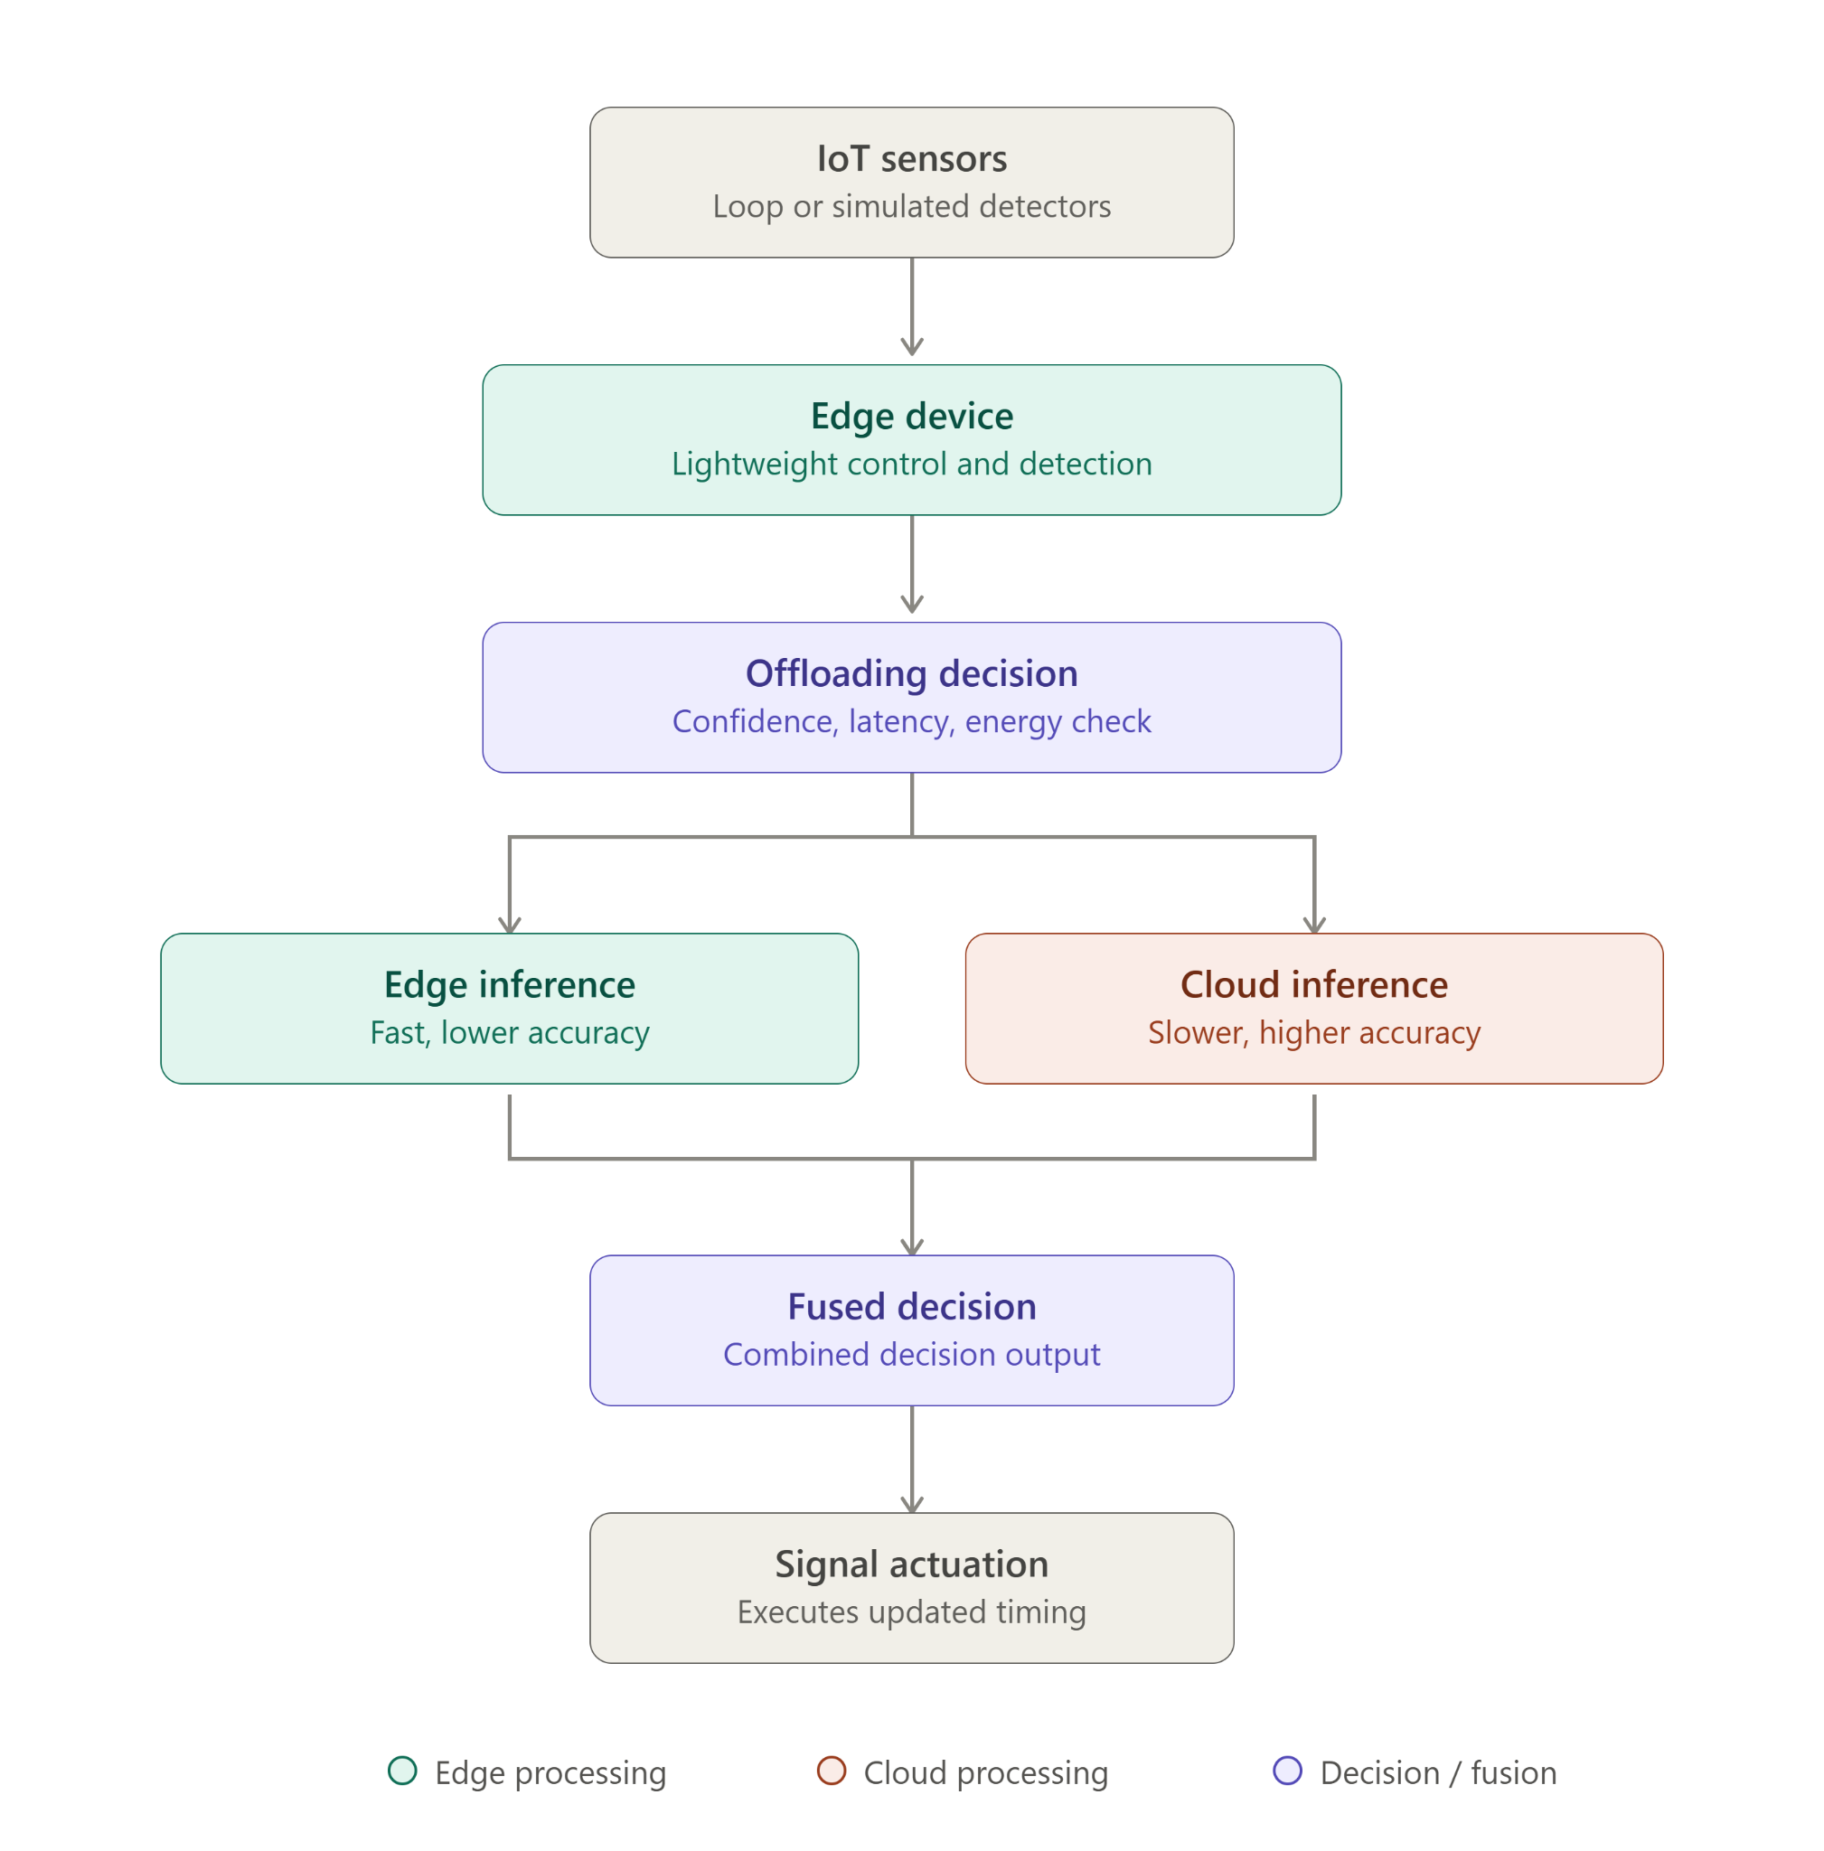
Methodology – System Architecture

Slide 18
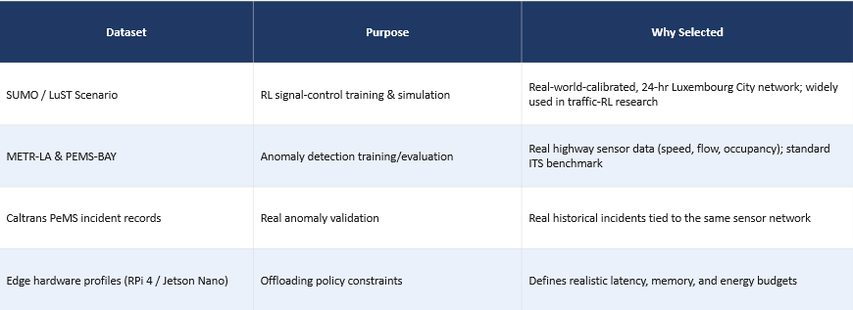
Dataset Plan
Tier | Source | Role in the framework | Status
1 | RESCO scenarios via sumo-rl (Cologne, Ingolstadt: 1–21 intersections) | Primary RL control testbed with fixed-time / actuated baselines | Verified: full 1-hour episode, 720 steps in ~30 s; 21-dim obs, 4 actions
1 | Controlled incident injection in SUMO | Primary anomaly ground truth — exact onset, location, duration, severity | Verified: injected stall raised network waiting time +51.6%
2 | METR-LA and PEMS-BAY | Sensor realism: noise, missingness, diurnal profiles; detector pre-training | Verified: speed only, no incident labels — not a benchmark
2 | LargeST (NeurIPS 2023) | Traffic flow (not speed alone), 8,600 sensors, 2017–2021 | Repository and schema reviewed
3 | Caltrans PeMS station + incident records | Confirmatory validation against real, not injected, anomalies | Free account, approved in 1–2 business days — off the critical path
— | Raspberry Pi 4 / Jetson Nano specs | Latency, memory and energy budgets for the offloading policy | Vendor datasheets; measured only if hardware is obtained

Slide 19
Data Types
Data type | Role | Verified characteristics
Microscopic simulation state (SUMO / TraCI) | RL state: queue length, waiting time, current phase | Step-resolution lane and vehicle state; 21-dim observation, 4 discrete phase actions on cologne1; ~30 s per one-hour episode on one CPU core
Labelled anomaly events (injected) | Ground truth for training and scoring the detector | Exact onset, location, duration and severity by construction; verified observable - +51.6% shift in network waiting time
Real sensor time-series — speed | Realism calibration and detector pre-training | METR-LA 207 × 34,272 (8.11% missing); PEMS-BAY 325 × 52,116 (0% missing, pre-imputed); single variable, no labels
Real sensor time-series — flow | Multi-variable detection input | 8,600 sensors, 2017–2021, with per-sensor metadata (district, freeway, lanes, direction)
Real incident / event logs | Confirmatory validation of the detector | ~40,000 detectors statewide; incident and lane-closure records; free registered account
Edge-hardware specifications | Latency / memory / energy budgets and container limits | Vendor datasheet values (CPU, RAM, power envelope)

Slide 20
Public Dataset Details
Dataset | Verified size / records | Features | Anomaly labels? | Used by
RESCO / sumo-rl | cologne1/3/8, ingolstadt1/7/21, grid4x4; 1–21 signalised intersections | Real Cologne & Ingolstadt geometry with calibrated demand | Yes — by injection (exact) | Ault & Sharon (2021); Alegre (2019)
SUMO / LuST | 24-h scenario, ~1,400 km; 203 signalised junctions carrying 201 TL programs; 3,146 loop detectors | SUMO network / route XML; vehicle, bus, pedestrian | Yes — by injection | Codeca et al. (2015, 2017)
METR-LA | 207 sensors × 34,272 intervals = 7,094,304 readings; Mar–Jun 2012 | Speed only (0–70 mph); 8.11% missing; worst sensor 79.9% complete | No | Li et al. (2018); Wu et al. (2019); Duan et al. (2025)
PEMS-BAY | 325 sensors × 52,116 intervals = 16,937,700 readings; Jan–Jun 2017 | Speed only (0–85.1 mph); 0% missing — already imputed | No | Li et al. (2018); Wu et al. (2019); Duan et al. (2025)

Slide 21
Public Dataset Details (Contd …)
Dataset | Verified size / records | Features | Anomaly labels? | Used by
LargeST | 8,600 PeMS sensors, 2017–2021 | Traffic flow + per-sensor metadata | No — forecasting benchmark | Liu et al. (2023)
Caltrans PeMS | ~40,000 detectors; over a decade of history | Flow, occupancy, speed; incident and lane-closure records | Yes — real records (account) | Chen et al. (2001)

Slide 22
Dataset Feasibility
Source | How it was verified | What was found
SUMO / LuST | Repository cloned, network parsed, scenario executed under SUMO 1.27.1 | Runs 600 s of simulated time in a few seconds of wall-clock, no errors. 203 signalised junctions carrying 201 traffic-light programs (not 199). Authors state it is validated only for SUMO 0.26 and point newer users to MoST.
RESCO via sumo-rl | Package installed; cologne1 episode executed end-to-end | 720 agent steps over a one-hour peak window in about 30 s; 21-dim observation, 4 discrete actions; waiting-time, queue and speed metrics exposed per step.
METR-LA | HDF5 obtained and profiled directly | 207 × 34,272 = 7,094,304 readings, Mar–Jun 2012. One variable: speed. 8.11% missing; worst sensor 79.9% complete. No incident, cause or severity field.
PEMS-BAY | HDF5 obtained and profiled directly | 325 × 52,116 = 16,937,700 readings, Jan–Jun 2017. Speed only. 0.00% missing the release is pre-imputed, so genuine sensor faults are invisible. No labels.
Incident injection | Identical SUMO runs with and without a stalled vehicle | Network-wide waiting time rose 51.6% the event is observable in detector-derivable signals, and its label is exact by construction.
Caltrans PeMS | Access conditions checked at the Caltrans source page | ~40,000 detectors; incident and lane-closure records integrated. Registration is free and accounts are typically approved within 1–2 business days.

Slide 23
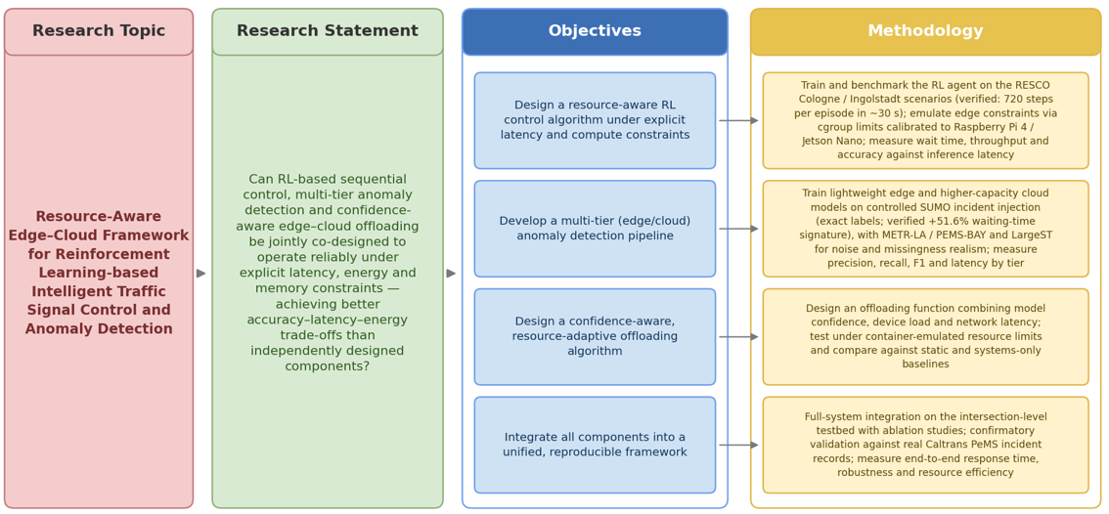
Research Traceability Mapping

Slide 24
Evaluation Criteria
Signal Control
Anomaly Detection
Offloading Policy
Overall System
Avg. waiting time, queue length, throughput (vehicles cleared per hour) vs. fixed-time / actuated baselines
Precision, recall, F1-score, detection latency, false-positive rate
% correct offload decisions, end-to-end latency, energy consumption
End-to-end response time; robustness under sensor noise / packet loss

Slide 25
04
Novelty & Research Contribution

Slide 26
Novelty & Research Contribution
First framework to jointly co-design RL control, multi-tier anomaly detection, and confidence-aware offloading as one optimization problem
A general offloading formulation combining model confidence with systems signals (latency, energy, device load)
A reproducible, containerized methodology for measuring accuracy-latency-energy trade-offs, generalizable beyond traffic control
Empirical evidence on how resource constraints jointly affect RL policy quality and detection accuracy typically studied in isolation

Slide 27
05
Feasibility Analysis

Slide 28
Feasibility Analysis
01
02
03
04
Technical Feasibility
Built entirely on free, open-source tools: SUMO, Python, PyTorch/TensorFlow, Stable-Baselines3, Docker
All required datasets (SUMO/LuST, METR-LA, PEMS-BAY, PeMS incidents) are free and publicly available
Edge constraints emulated via container resource limits (cgroups) calibrated to Raspberry Pi 4 / Jetson Nano specs
Modular architecture allows each component (signal control, anomaly detection, offloading) to be developed and tested independently

Slide 29
Feasibility Analysis
01
02
03
04
Operational Feasibility
Reduces reliance on manual/fixed-time traffic signal management
Improves responsiveness to real-time traffic anomalies (accidents, sudden congestion)
Simulation-based evaluation avoids the need for real-world traffic disruption during testing
Framework is extensible to additional intersections or a larger network in future work

Slide 30
Feasibility Analysis
01
02
03
04
Operational Feasibility
No licensing costs, all software (SUMO, Python ecosystem, Docker) is open-source
Model training feasible on a standard workstation or free-tier / low-cost cloud GPU credits
Optional physical edge hardware (Raspberry Pi 4 / Jetson Nano) costs under Rs. 80000 if used for validation
No paid dataset subscriptions required for the core project scope

Slide 31
Feasibility Analysis
Legal & Ethical Feasibility
Consideration | Position
Data licensing | LuST is MIT-licensed; SUMO, sumo-rl and the RESCO scenarios are open-source; LargeST is a public NeurIPS Datasets & Benchmarks release. All are free for academic use.
Personal data | No personal data is used. Loop-detector records are aggregated vehicle counts and speeds; the Caltrans incident records contain no personal identifiers.
Terms of access | Caltrans PeMS requires a free registered account; data will be used strictly within its stated terms and will not be redistributed.
Public-safety risk | Evaluation is entirely simulation-based. No live signal infrastructure is controlled at any point, so no road user is exposed to risk from the research.
Reproducibility and disclosure | Code, container definitions, trained models and scenario configurations are released openly, with the resource constraints and their calibration documented.

Slide 32
06
Research Timeline

Slide 33
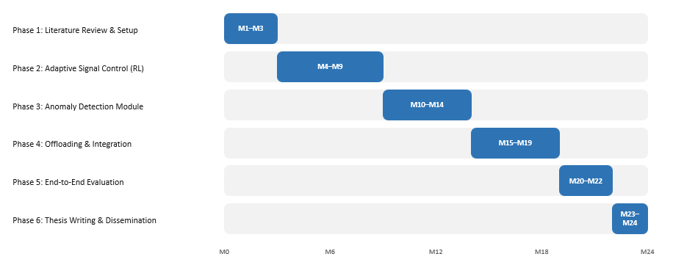
Research Timeline

Slide 34
References
[1] Genders, W., & Razavi, S. (2016). Using a deep reinforcement learning agent for traffic signal control. arXiv:1611.01142.
[2] Wei, H., Zheng, G., Yao, H., & Li, Z. (2018). IntelliLight: A reinforcement learning approach for intelligent traffic light control. ACM SIGKDD, 2496–2505.
[3] Li, Y., Yu, R., Shahabi, C., & Liu, Y. (2018). Diffusion convolutional recurrent neural network: Data-driven traffic forecasting. ICLR.
[4] Codeca, L., Frank, R., Faye, S., & Engel, T. (2017). Luxembourg SUMO Traffic (LuST) Scenario: Traffic demand evaluation. IEEE ITS Magazine, 9(2), 52–63.
[5] Chen, C., Petty, K., Skabardonis, A., Varaiya, P., & Jia, Z. (2001). Freeway performance measurement system: Mining loop detector data. TRR, 1748(1), 96–102.
[6] Shi, W., Cao, J., Zhang, Q., Li, Y., & Xu, L. (2016). Edge computing: Vision and challenges. IEEE IoT Journal, 3(5), 637–646.
[7] Ault, J., & Sharon, G. (2021). Reinforcement learning benchmarks for traffic signal control (RESCO). NeurIPS Datasets and Benchmarks Track.
[8] Liu, X., Xia, Y., Liang, Y., et al. (2023). LargeST: A benchmark dataset for large-scale traffic forecasting. NeurIPS Datasets and Benchmarks Track.
[9] Peddiraju, S. S., Harapanahalli, K., Andert, E., & Shrivastava, A. (2024). IncidentNet: Traffic incident detection, localization and severity estimation with sparse sensing. arXiv:2408.00996.

Slide 35
References (Contd…)
[10] Behera, A. P., Daubaris, P., Bravo, I., et al. (2024). Exploring the boundaries of on-device inference: When tiny falls short, go hierarchical. arXiv:2407.11061.
[11] Nguyen, D. V. A., Azevedo, C. L., Toledo, T., & Rodrigues, F. (2025). Robustness of RL-based traffic signal control under incidents: A comparative study. arXiv:2506.13836.
[12] Xiao, F., Lu, J., Li, L., Tu, W., & Li, C. (2025). Advances in reinforcement learning for traffic signal control: A review of recent progress. Intelligent Transportation Infrastructure, 4, liaf009.
[13] Ngo, D., Park, H.-C., & Kang, B. (2025). Edge intelligence: A review of DNN inference in resource-limited environments. Electronics, 14(12), 2495.
[14] Duan, M., Sun, S., & Liu, M. (2025). A multimodal deep fusion framework for highway traffic anomaly detection. Scientific Reports, 15, 33573.
[15] Xiao, H., Li, H., Wang, Z., et al. (2026). Intelligent traffic signal control based on reinforcement learning: A survey. Artificial Intelligence Review, 59, 128.
[16] AlSaqabi, Y. (2026). Reinforcement learning-based traffic signal control for IoT-enabled intersections. arXiv:2606.22108.
[17] Moothedath, V. N., Agarwal, U., Umeshraja, N., et al. (2026). Inference offloading for cost-sensitive binary classification at the edge. AAAI-26. arXiv:2509.15674.
[18] Saha, S., & Debroy, S. (2026). Deep reinforcement learning-driven edge offloading for latency-constrained XR pipelines. IEEE/ACM CCGrid 2026. arXiv:2603.16823.

Slide 36
Thanks!
Q&A
Please keep this slide for attribution

